Slide 1
Session 2
Equipment Requirements for
Adaptive Traffic Control
SCOOT
Axel Reissnecker, EAGLE Traffic Control Systems, Austin, TX
TRB Workshop on
Adaptive Traffic Signal Control Systems
Jan 9, 2000

Slide 2
Content of Presentation
Installations in US and Canada
System Architecture
Central Computer Requirements
Communications Requirements
Local Controllers
Data Requirements
Installation Costs
O&M Costs

Slide 3
SCOOT installations in US and Canada
City Vendor # of intersections
Anaheim, CA EAGLE/Siemens 20
Arlington Cty, VA EAGLE/Siemens 65
Halifax, NS GEC 60
Minneapolis, MN Siemens 55
Orange Cty, FL EAGLE/Siemens 15
Oxnard, CA GEC 20
Red Deer, AB GEC 30
San Diego, CA Peek Status unknown
Toronto, ON Siemens 240
University of Utah System for research (CORSIM)

Slide 4
System Architecture
Second-by-second command and monitoring system
Timing algorithms in central processor
Utilizes the power of the local controller:
minimums, clearance, local actuation and detector preprocessing handled by local controller

Slide 5
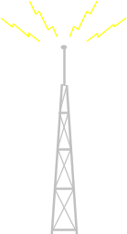
System Architecture
SCOOT/ASTRID/
INGRID Server
ACTRA Server
Modem
Remote Diagnostics
Terminal
Server
Hub
Private Ethernet
10/100 Public Ethernet
Laser Report
Printer
Comm.
Servers
SCOOT Detector
Dot-Matrix
Log Printer
Once
per sec.
Controller 1
Modem Dial-in
Validation
Local Detector
Once per min.
SCOOT Detector
Roving Terminal
Validation
Up to 16 drops per channel
@ 9600 baud
Local Detector
Controller n

Slide 6
Central Computer Requirements
SCOOT server
  DEC Alpha workstation(s), running OpenVMS
Operator workstations
  PC running Windows 95/98/NT/2000
  LAN connected via X-Windows emulation
  Remote dial-ins via terminal servers
  Interface to existing network(s) /and workstations possible
Printers
  Continuous feed log printer
  Windows compliant report printer(s)

Slide 7
Communications Requirements
Transmission Media
  Leased line, copper cable, fiber optic, or combinations
  At 1200 baud 6 drops per channel
  At 9600 baud 16 drops per channel
Communications Methodology
  Frequency Shift Keying (FSK)
  Fiber Optic (Single or Multi-mode)
  Fixed or Spread Spectrum Radio

Slide 8
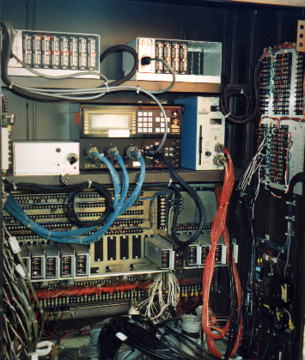
Local Controllers
Use existing controller
  Controller firmware
  upgrade (EPAC)
  Addition of dedicated
  comm. unit
  Examples:
  Toronto, Anaheim
Replace Controller
  EPAC
  2070. 2070L, 2070N

Slide 9
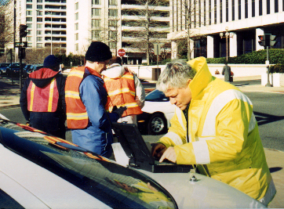
Data Requirements
Detection on every link for
which full optimization required
Detectors generally located
at upstream end of link
Connection to central computer
achieved via upstream intersection
Links with no detection run fixed length or can have data derived from upstream links
- Fixed length phases can be varied by time of day

Slide 10
Installation Costs
Controller Upgrades $0 - $5,000
Detectors 5-7 per intersection
Loop Siting,
Validation, Fine Tuning $1,000 per intersection
Signal Plans/Updates None
Central Equipment $30,000
Communications Dependent on existing infrastructure

Slide 11
O&M Costs
(compared to standard traffic control systems)
Controller Same
Detectors Increases
Loop Siting,
Validation, Fine Tuning None (One-time cost)
Signal Plans/Updates Decreases
Central Equipment
Communications
Same as any
computer system

